Slide 1
1) The geochemically scarce metals 2) Mining Methods

Slide 2
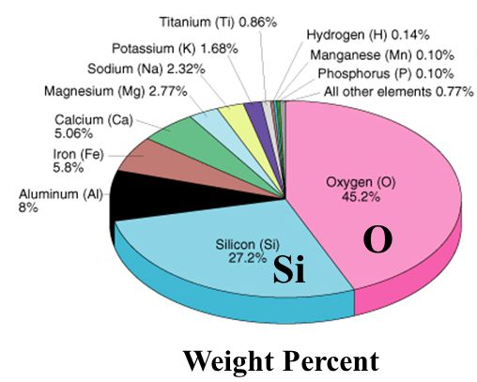
Scarce metals
Average abundance of elements in continental crust
Used in small amounts
Can control the properties of alloys of the abundant metals
<0.1 % average abundance in crust
>30 scare metals are mined
Fill a wide, varied range of needs
Distribution of electricity, phones, radio, TV, cars, planes, rockets, computers, internet…
keep our modern society running efficiently and effectively
Notes:
Some as little as 1/1,000,000th of a percent average crustal abundance

Slide 3
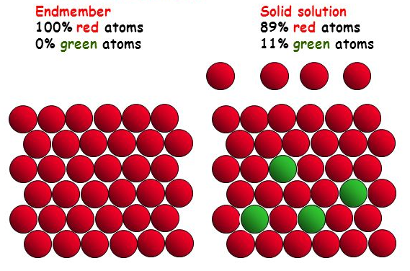
Scarce metal occurrence
Common mineral
Atomic substitution
How are the scarce metals distributed in MOST of Earth’s crust?
Present in common minerals by atomic substitution
eg. Ni can substitute for Mg in olivine (Mg₂SiO₄)
BUT – the number of scarce metal atoms that can substitute into common minerals is limited
When that limit is exceeded,
→we have reached saturation of that metal
Notes:
Saturation of the solid solution – this is when you can form minerals of the scarce metals

Slide 4
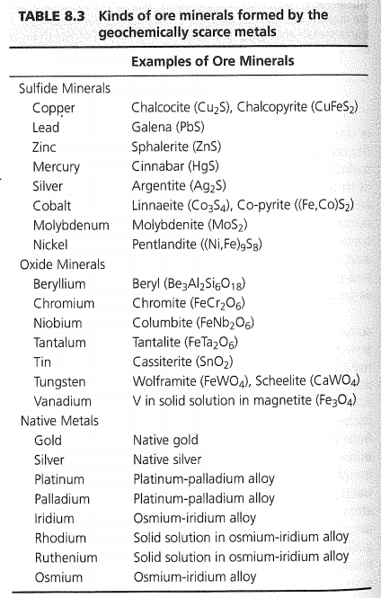
Ore minerals of the Scarce Metals = minerals in which scarce metals are key component of the mineral,
Formed when you reach saturation of the scarce metal in common minerals
→ RARE circumstances (ore deposits!)
Cut-off grades vary – e.g…
0.0001% gold
1-3% zinc
40% chromium and manganese
Concentration factors required to reach saturation can be enormous
Notes:
not just present in small quantities, substituting for other common metals
Concentration factors: Mercury 12,500 x greater than average crustal abundance
Thus ore deposits of scarce metals tend to be small and scarce relative to the abundant metal deposits

Slide 5
Classification by usage
Ferro-alloy metals
Base metals (nonferrous metals)
Precious metals
Special metals
Notes:
1 – primarily used to alloy with iron
2 – purposes other than alloying with Fe
3 – non-reactive (thus corrosion resistant
4 – range of special properties

Slide 6
Chapter 8 – useful reading – Will scan and post this chapter
Details the most important scarce metals
Systematically describes
Uses
Geologic occurrence
Production and reserves
I think it is quite interesting stuff, but I want you to read it on your own
Familiar with the different important scarce metals
Their geologic occurrence
And their most important uses – how do they impact our lives?

Slide 7
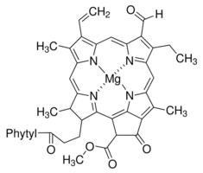
A few interesting tidbits to highlight
Vanadium – Substitutes for Fe and Mg
LII, weathering – oxidizes to very soluble form
Substitute into cells in organic matter (e.g. hemoglobin and chlorophylls) – appear as “cages” with V in center called porphyrins
Thus extractable from coal and Tar (heavy oil)
Chlorophyll

Slide 8
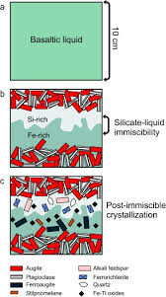
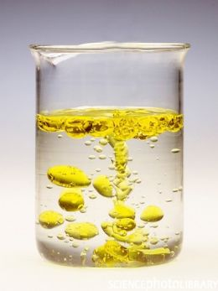
A few interesting tidbits to highlight
Nickel – Liquid immiscibility in mafic magmas
When magma starts to cool, minerals crystalize because the magma becomes saturated in those mineral’s chemical constituents
Magma may become saturated in a compound, but still be hotter than the melting temperature of that compound
The compound may separate out into immiscible liquid blebs (like oil and water)
Notes:
Pyrrhotite does this a lot

Slide 9
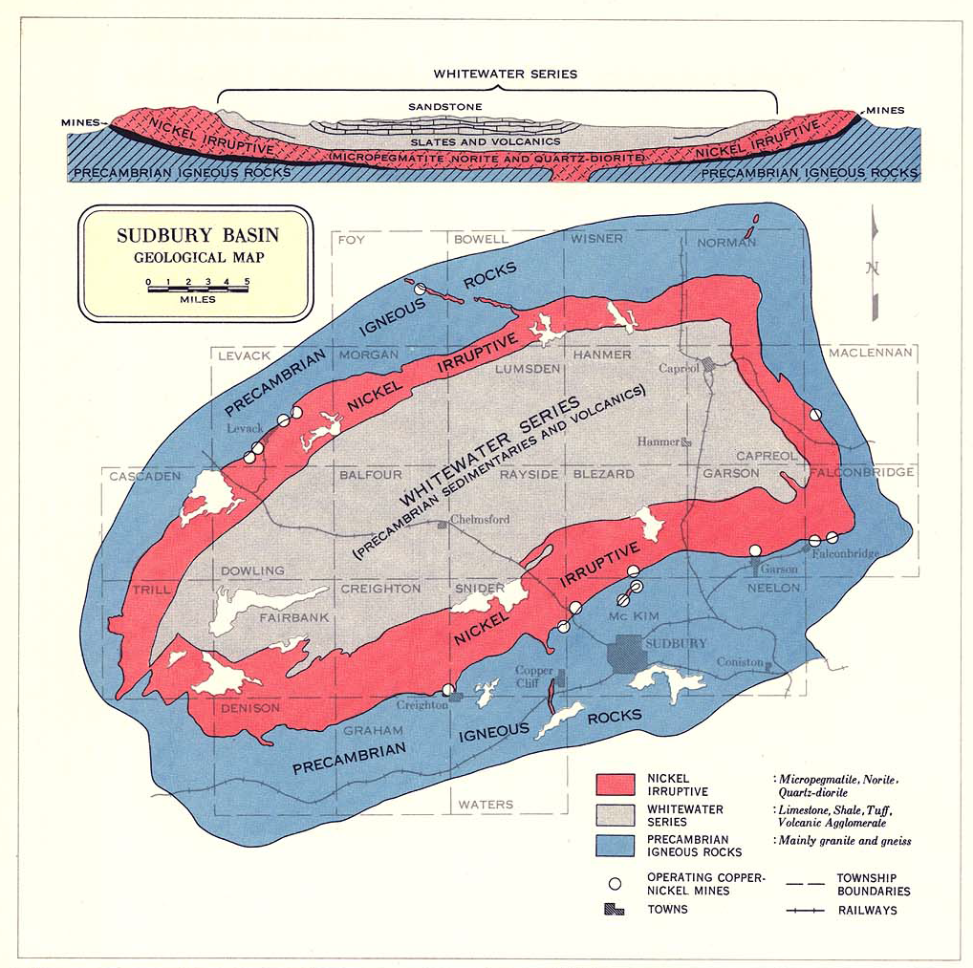
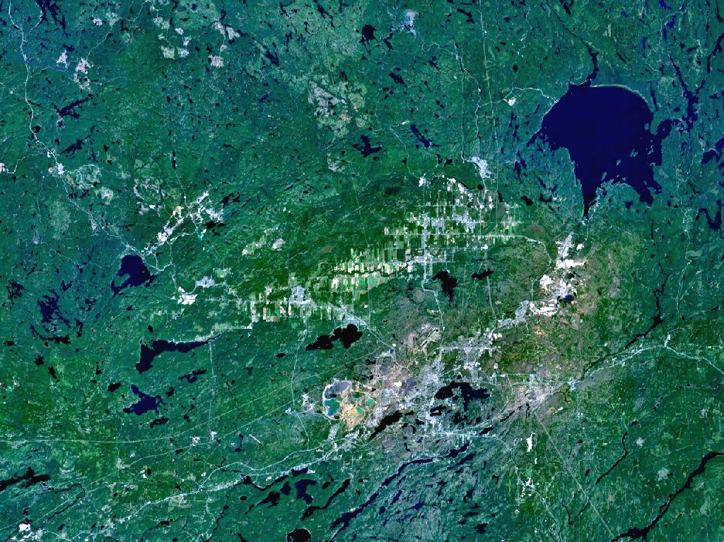
A few interesting tidbits to highlight
Sudbury Ontario – large Ni and Cu mine
Formed from a large meteorite impact!

Slide 10

A few interesting tidbits to highlight
Cobalt – German miners
Arsenic bearing silver-cobalt ores
Arsenic gas caused ulcers on bodies of miners
Miners thought they were caused by silver stealing goblins called Kobolds who replaced good silver with useless cobalt-arsenides

Slide 11
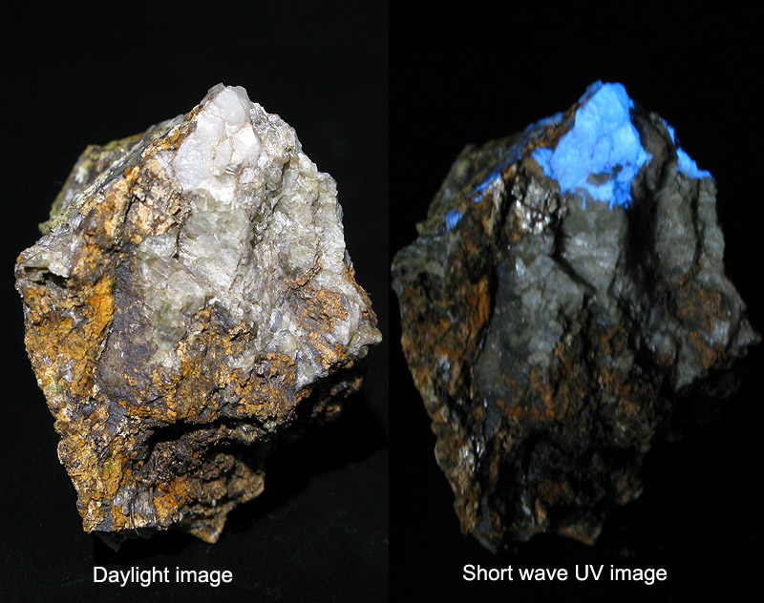
A few interesting tidbits to highlight
The tungsten ore Sheelite glows bright blue under UV light!
Formed in veins
Important use is for making tungsten carbide, which has hardness approaching that of diamond

Slide 12
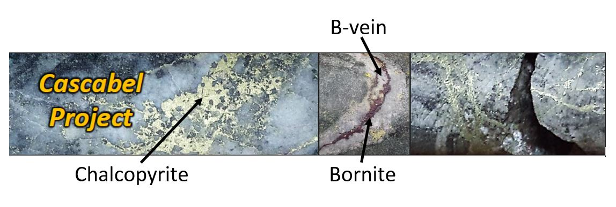
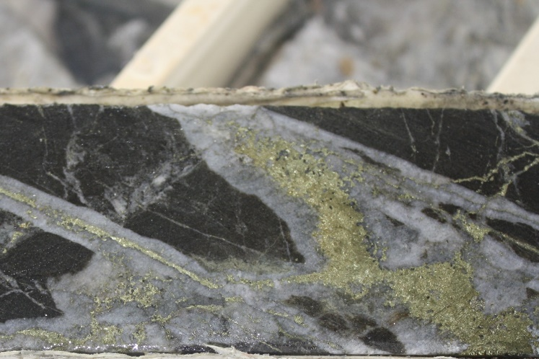
A few interesting tidbits to highlight
Copper – LOTS of deposits
Most important ores are sulfide minerals
We talked about Porphyry deposits – formed by hydrothermal fluids associated with sub-volcanic igneous intrusions
→ Role of underground steam explosions in this process
Notes:
Water content of magma increases as non-hydrous phases crystalize – water content increases
These magmatic derived fluids can cause steam explosions underground – shatters the rocks, and then minerals (including sulfide minerals) can crystalize in those cracks forming veins
Veins are too scattered to mine individually, so we crush up the whole body of rock and leach out the copper

Slide 13
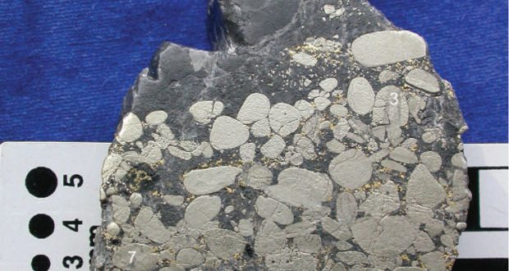
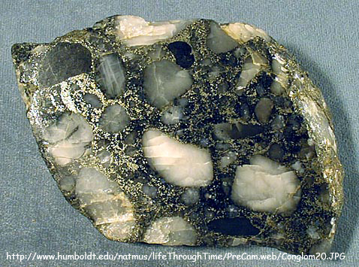
A few interesting tidbits to highlight
Gold
Low grade deposits:
Mostly those deposit types that form via hydrothermal fluids
Veins
Placer deposits (e.g. Witwatersrand in South Africa)
Notes:
Witwatersrand = delta conglomerates – original source of gold long eroded away

Slide 14
Mining Methods
Surface
Open Pit
Strip/Mountaintop Removal
Underground

Slide 15
Surface Mining
Accounts for 2/3 of world’s mineral production
Especially the production of sand and gravel, crushed stone, and phosphates, coal, copper, iron, and aluminum
This includes open pit mining and strip mining

Slide 16
Advantages of Surface Mining
Safer
Less expensive
Fewer complications with water, bad air, electricity and falling rock than underground mines
Less regulation than underground mines

Slide 17
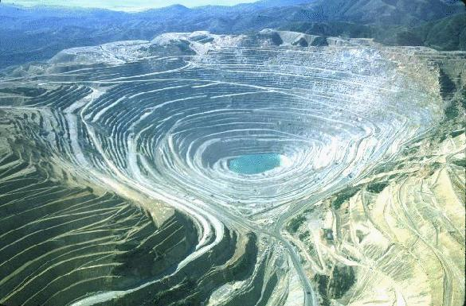
Bingham Copper Mine, Utah
Deepest open pit copper mine in the world!

Slide 18
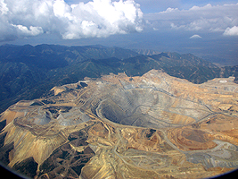
Almost three miles wide and a half mile deep.

Slide 19
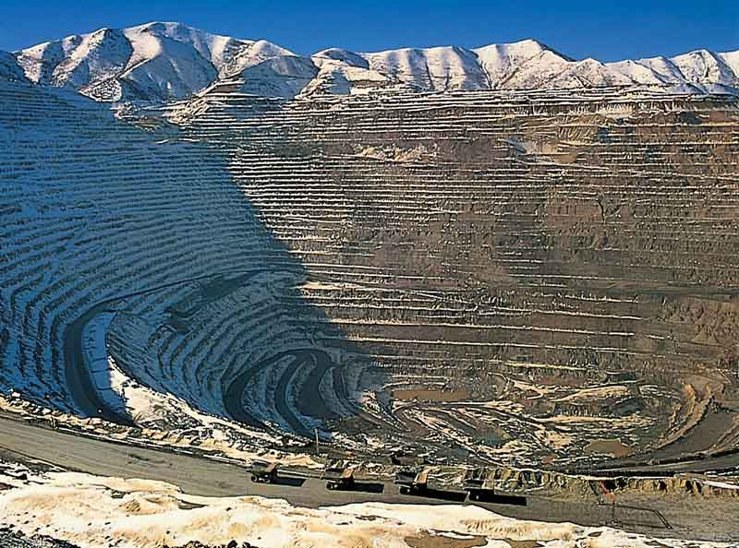
Notes:
Describe what surface mining is – dig out pit, process ore, all non ore rock that is removed plus the waste rock after ore processing goes in tailings piles

Slide 20
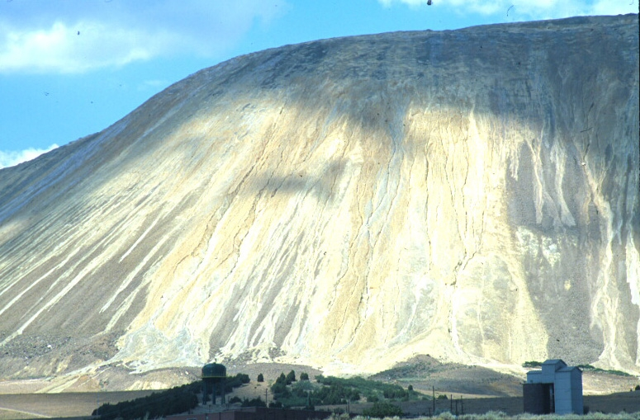
Bingham Tailings Waste Pile

Slide 21
Why an Open Pit?
Open pits are economical where:
large tonnages of reserves are involved
high rates of production are desired
overburden is thin enough to be removed

Slide 22
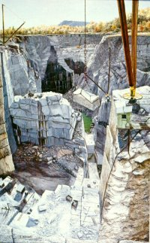
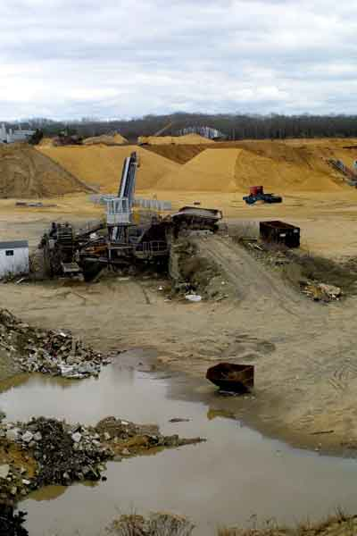
Quarry
Quarry is an open pit mine specifically for excavating building stone
Granite Quarry and Sand Pits

Slide 23
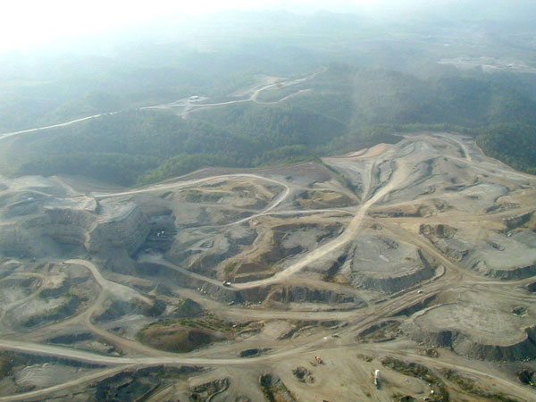
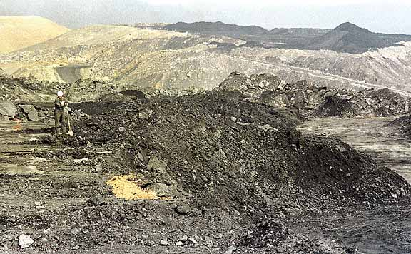
Strip Mining
Why a strip mine?
Used where material to be extracted forms a flat lying layer below the surface, with minimal overburden
**generally used for coal

Slide 24
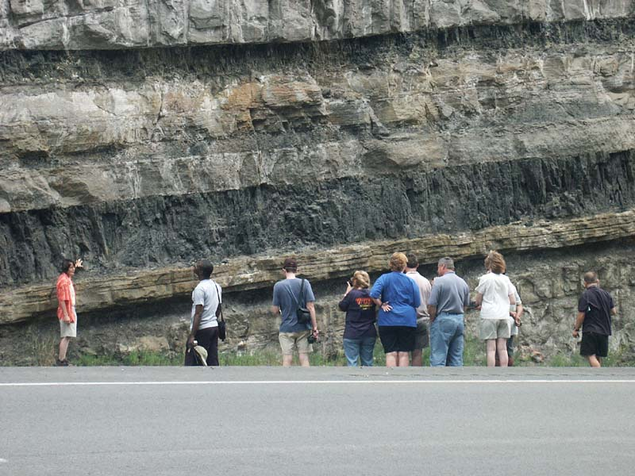
Coal Seam in Road Cut

Slide 25
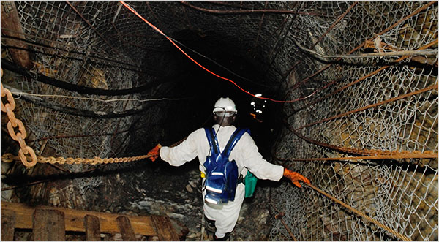
Underground Mining
Used to extract a solid mineral resource that is too deep to allow for economic surface extraction
Composed of shafts, (horizontal) adits and inclines
Potential Issues
Ventilation is big concern here – many smaller shafts needed for ventilation
Flooding can be a problem
Temperature – too hot to work
Mine collapse

Slide 26
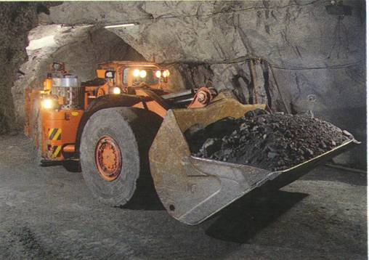
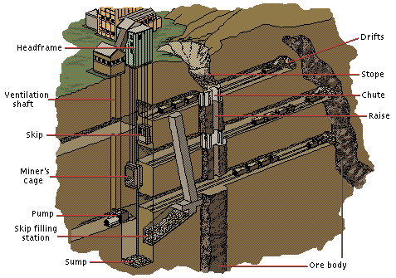
Underground Mining

Slide 27
Underground Mining Methods
Method used to mine depends upon type of deposit – shape, size, grade
Drilling and Blasting is used in most mines - then removal with automatic diggers onto rail cars or elevators to the surface
Coal mines often use continuous mining machines

Slide 28
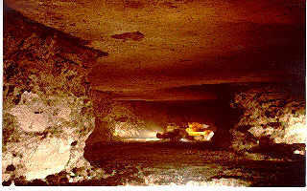
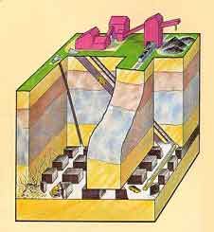
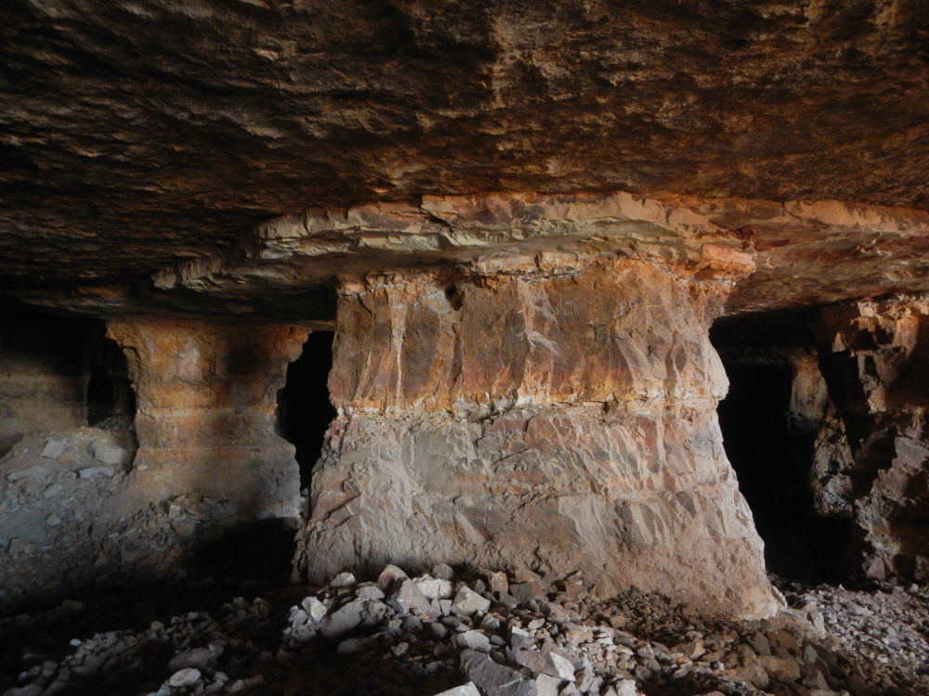
Room and Pillar Method
Implication: you leave some of the ore to hold up the cavern

Slide 29
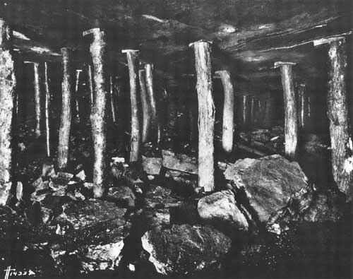
Robbing the Pillars
This was done in coal mines when the
high grade coal was exhausted

Slide 30
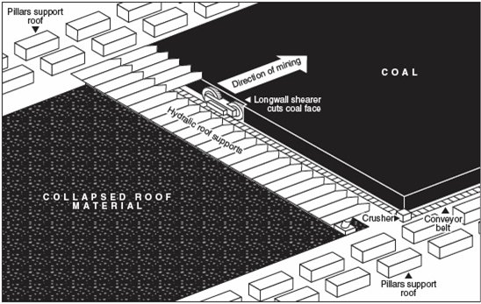
Long Wall Mining: What you mine you let collapse

Slide 31
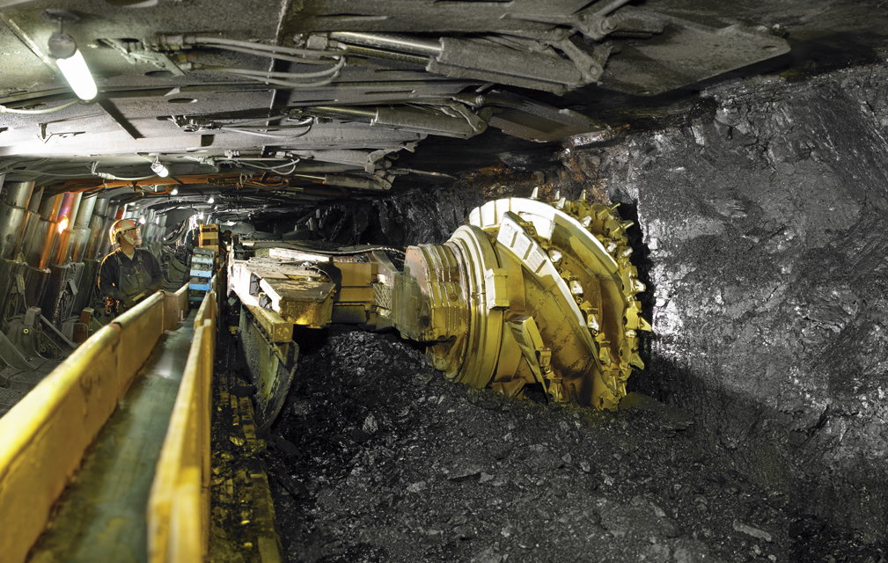
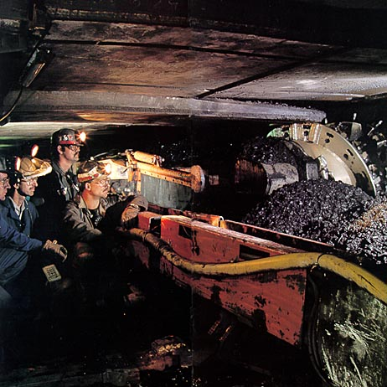
Long Wall Mining: What you mine you let collapse
In the photo on the right note the hydraulic roof supports above and behind the miner

Slide 32
Strength of the rocks and Mining
The strength of the rocks being mined is a large determinant in the mining method and type of mining cavern produced
Sedimentary rocks are usually not as strong – roof collapse is a big concern

Slide 33
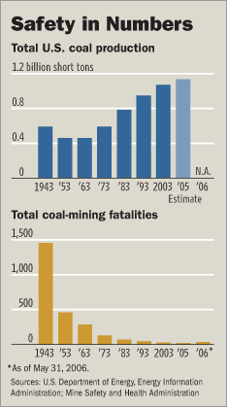
Underground Mining Dangers
Rock falls – collapsing roofs
Poisonous and combustible gases – no use of gasoline in mines
Methane generation – coal mines

